Slide 1



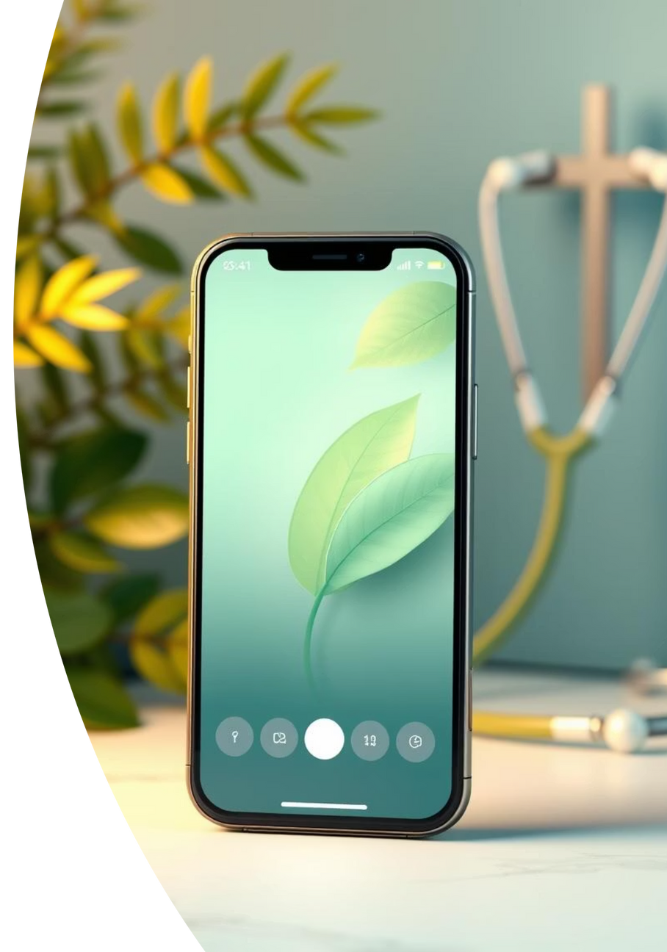



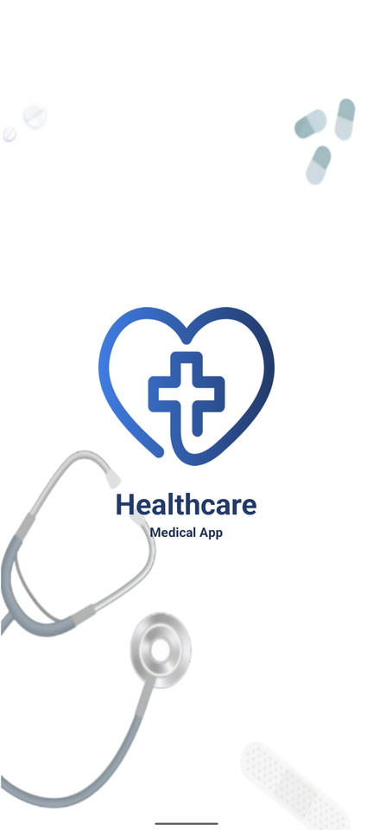


Health Care App
Android(Java/XML/SQLite)
Notes:
1.7.2013
1
‹#›

Slide 2
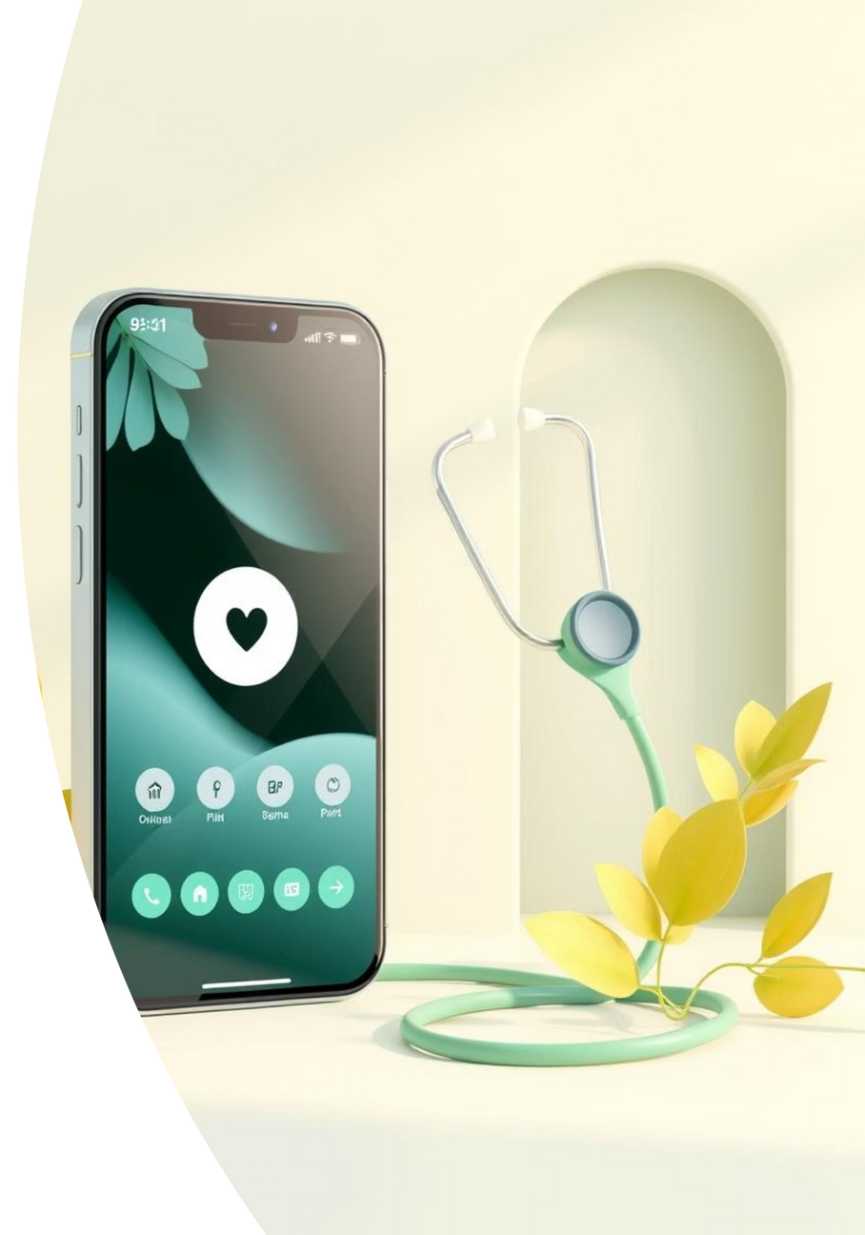
Introduction
The Health Care Android App is a mobile solution for healthcare needs.
Purpose: help users search doctors, order medicines, read health news, and get emergency support.
Notes:
1.7.2013
3
‹#›

Slide 3
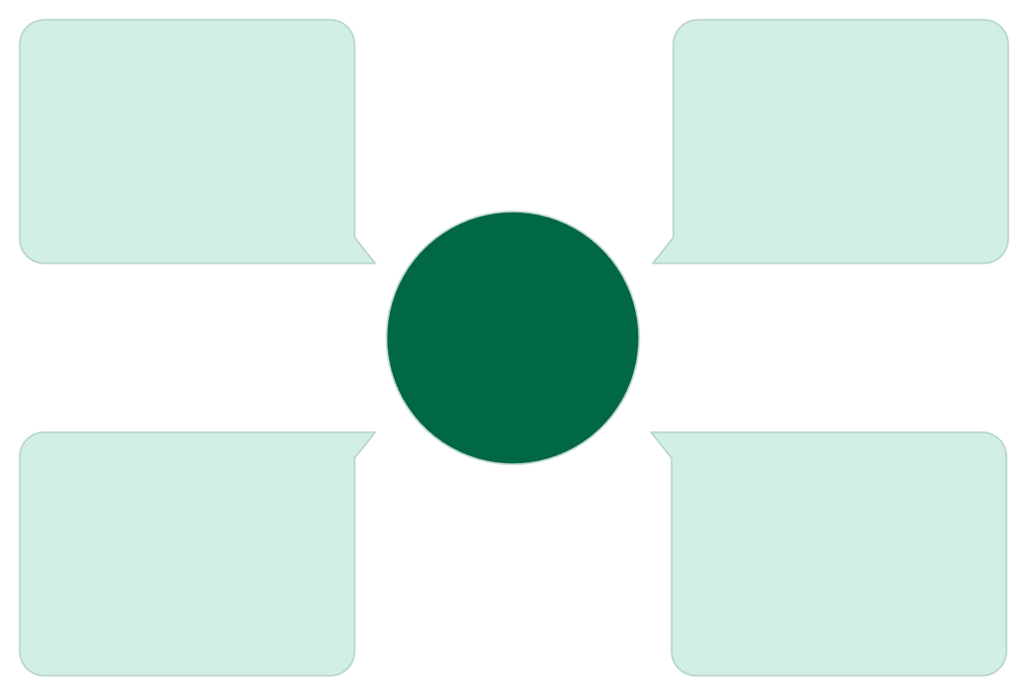
Why This App?
Healthcare services are scattered across clinics, pharmacies, and websites, making it hard for users to access them quickly.
Patients need one simple mobile app to manage doctors, medicines, health records, and emergencies in a single platform.
Most existing apps are either costly, complex, or not designed for students and general patients.
A unified app can save time, improve emergency response, and provide secure record-keeping.
Medical Records
Doctor Access
Store health files securely
Find and book clinicians
One
Health
App
Emergency Help
Medication
Order prescriptions easily
Ambulance & urgent care
Notes:
1.7.2013
4
‹#›

Slide 4

Objectives
Main goal: Make healthcare easy and digital.
Target users: general patients and peoples.
Support both basic and emergency health needs.
Notes:
1.7.2013
5
‹#›

Slide 5






Features
Login & Registration
Medicine search and order system
Doctor search and details
AI Chat for health queries
Health news updates
Notifications & SOS (Ambulance 108)
Notes:
1.7.2013
6
‹#›

Slide 6
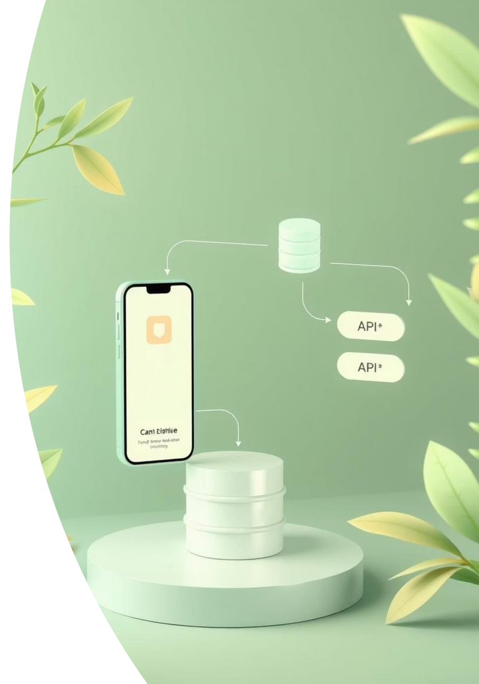
System Architecture (DFD / Flow)
User interacts with app → app connects with database.
External APIs: Open-Router (AI Chat), Newsdata.io (Health News).
SOS connects to Ambulance 108, Maps for hospitals.
Notes:
1.7.2013
7
‹#›

Slide 7

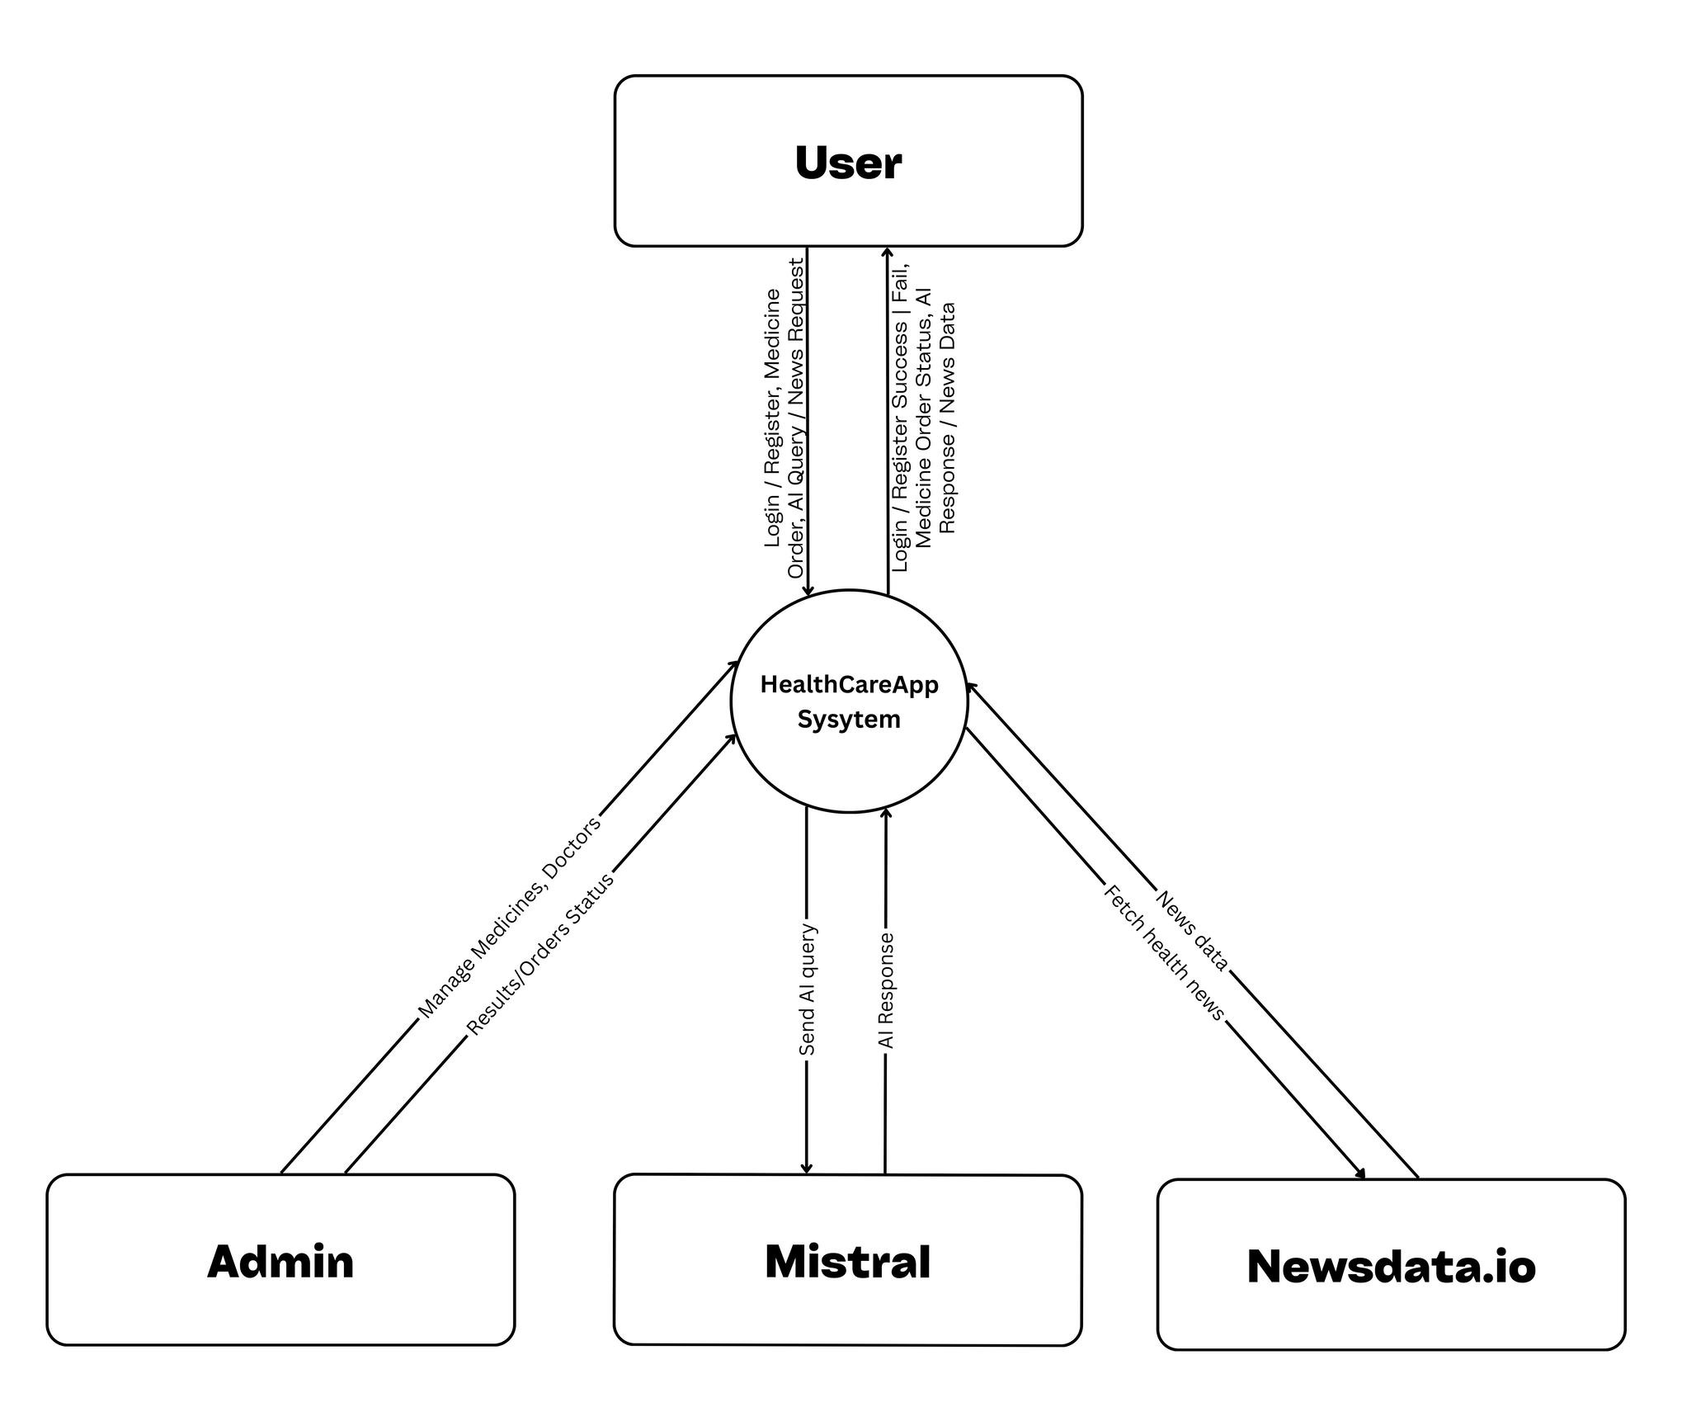



DFD LEVEL 0
Notes:
1.7.2013
8
‹#›

Slide 8
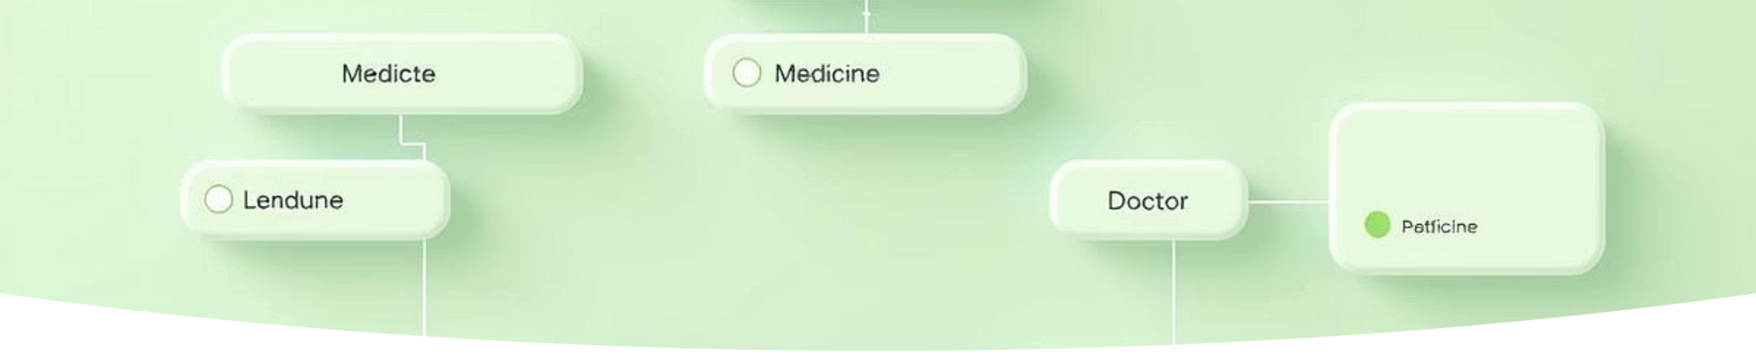
ER Diagram / Database Design
Tables: User, Medicine, Cart, Order, Doctor, Notification, Search History.
Relationships: User → Cart → Order; User → Search History; User ↔ Doctor.
Notes:
1.7.2013
11
‹#›

Slide 9
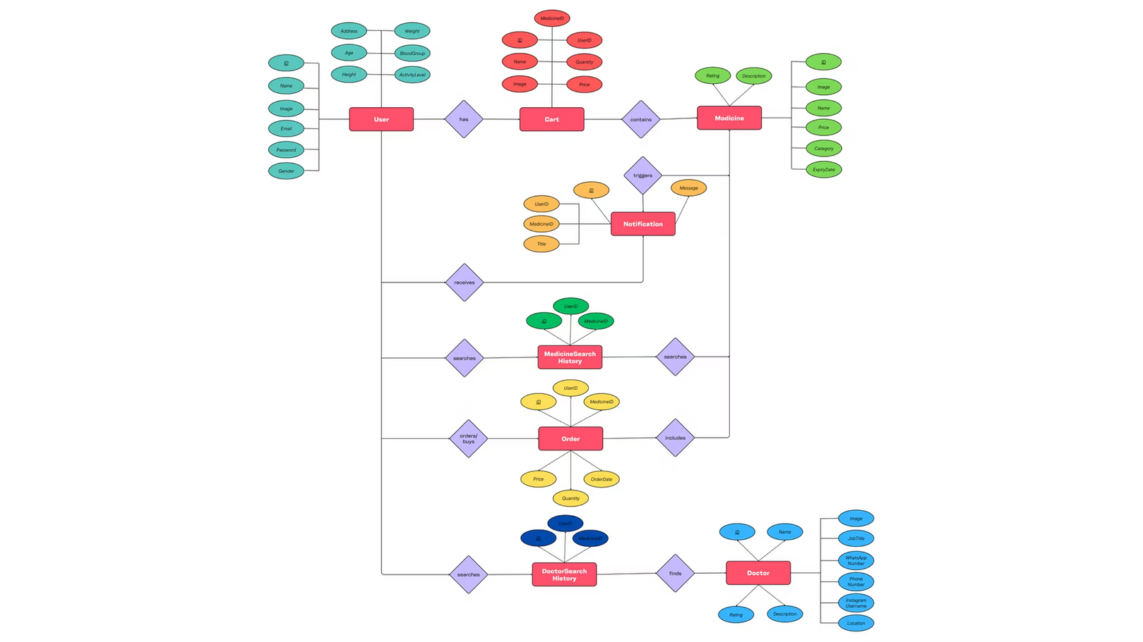
ER Diagram
Notes:
1.7.2013
12
‹#›

Slide 10




Modules
User module:
Admin module:
Profile, search, order medicines, notifications.
Manage users, doctors, medicines, and orders.
Notes:
1.7.2013
13
‹#›

Slide 11

Technology Used
Android (Java/XML) for development.
SQLite for local database.
APIs: Open-Router for AI chat, Newsdata.io for news.
Protocol: SMTP for sending OTP mail in forgot password.
Tools: Android Studio, Figma.
Notes:
1.7.2013
14
‹#›

Slide 12
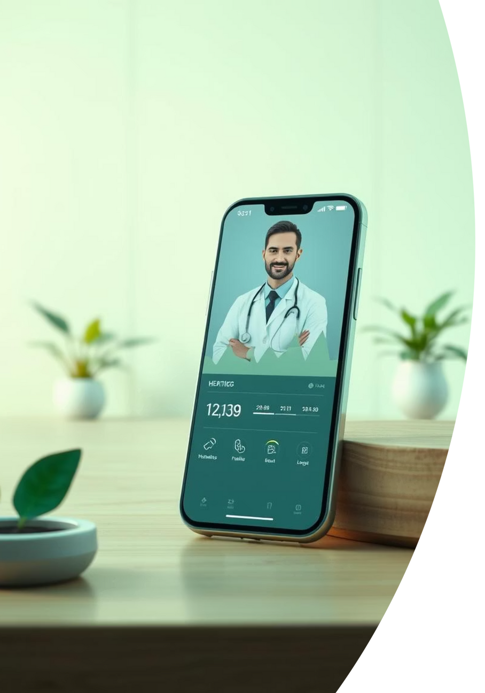
Future Enhancements
While the current version offers comprehensive features, we envision several future enhancements to further improve the app.
Integration with wearable health devices for real-time data.
Telemedicine features for online consultations.
Personalized health recommendations based on user data.
Multi-language support for broader accessibility.
Advanced analytics for health trends and insights.
Notes:
1.7.2013
15
‹#›

Slide 13
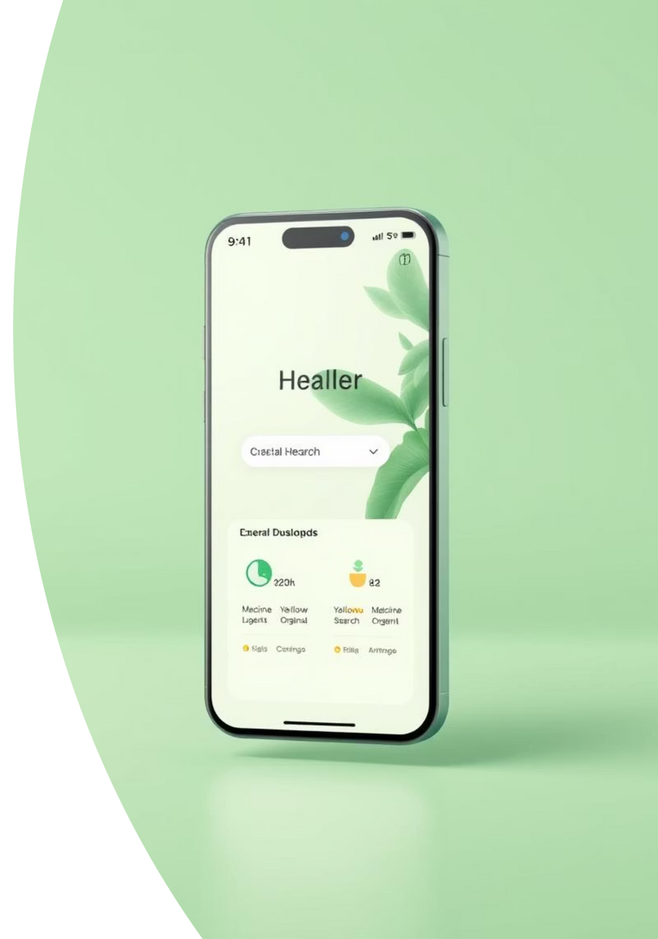
UI/UX (Screenshots)
Login Screen: A secure and straightforward interface for user authentication, featuring email and One-Time Password (OTP) verification for enhanced security.
Dashboard: A user-centric home screen providing quick, intuitive access to all primary features such as doctor consultations, medicine orders, and health news.
Medicine Search Screen: An efficient and easy-to-navigate layout allowing users to swiftly find medicines, view detailed information, and manage their orders.

Slide 14

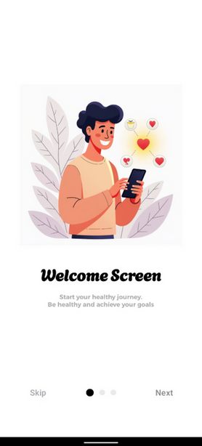
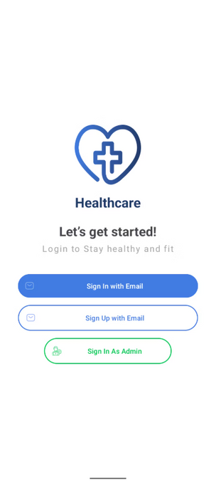

Basic Screens
Notes:
1.7.2013
17
‹#›

Slide 15
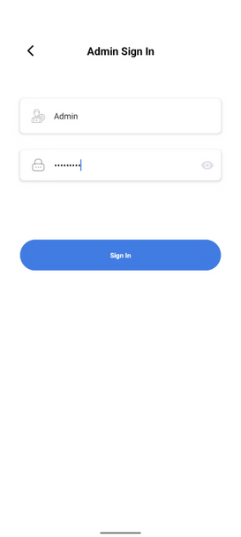
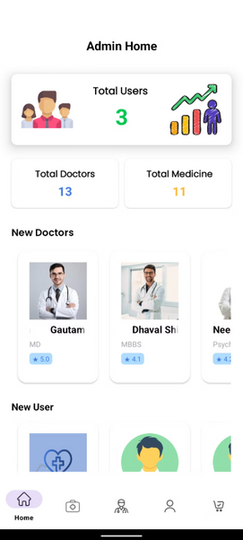
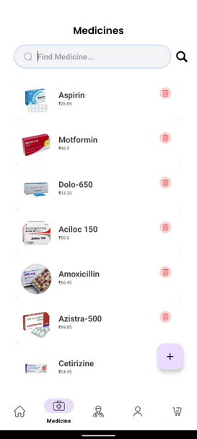
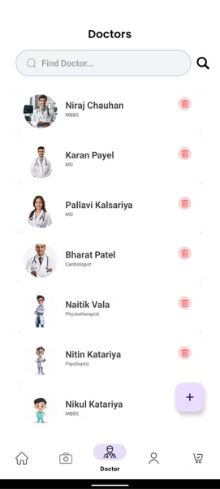
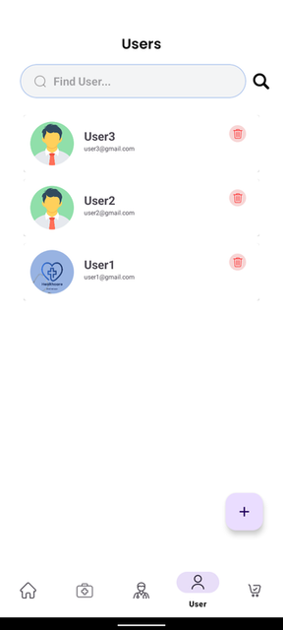
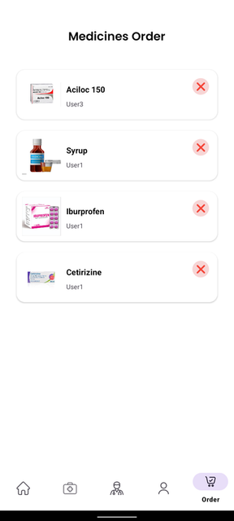

Admin Screens
Notes:
1.7.2013
18
‹#›

Slide 16
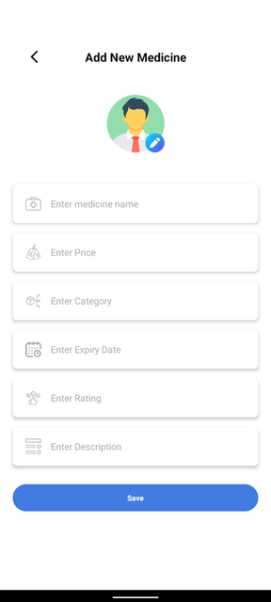
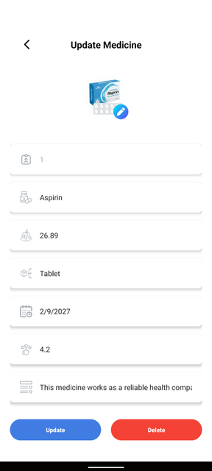
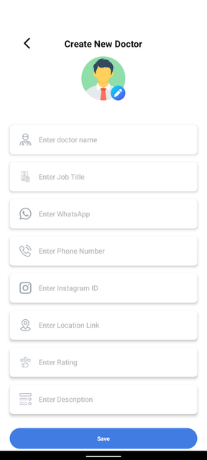
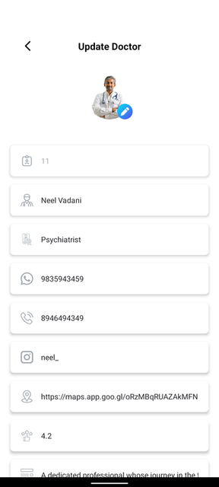
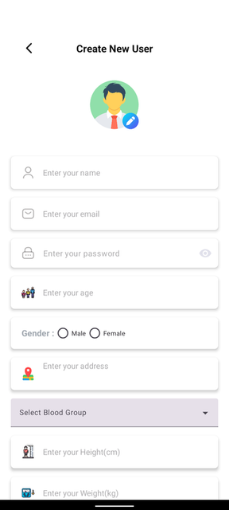
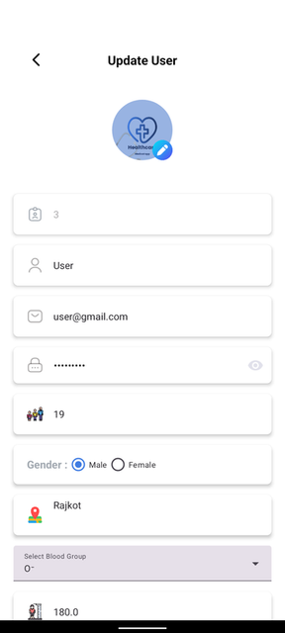
Admin Common Screens

Slide 17
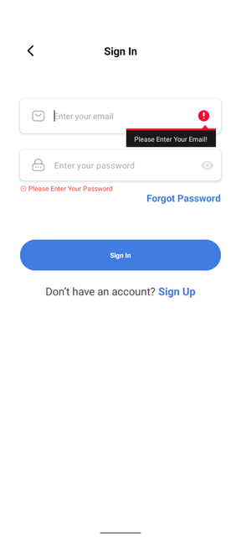
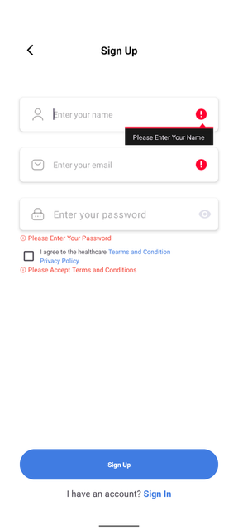
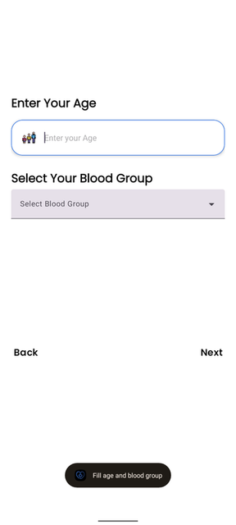
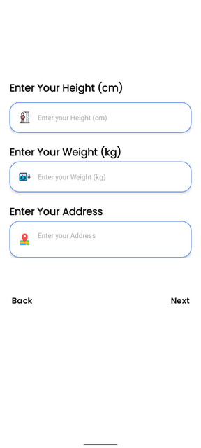
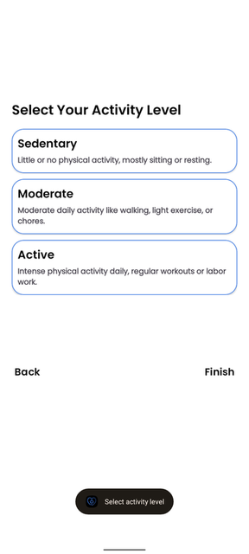
User Sign In & Sign Up Screens
Dashboard Screen
Dashboard Screen

Slide 18
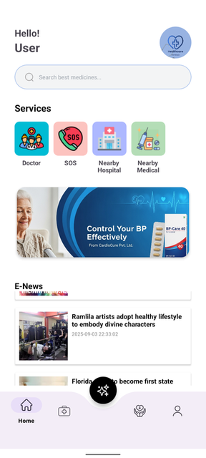
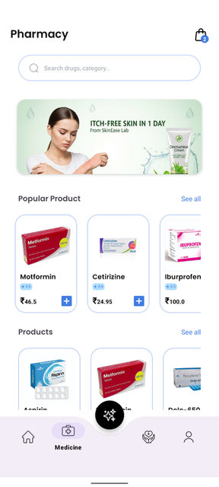
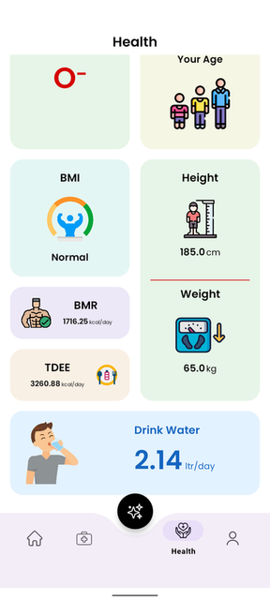
User Screens
Medicine
After Sign In or Sign Up

Slide 19
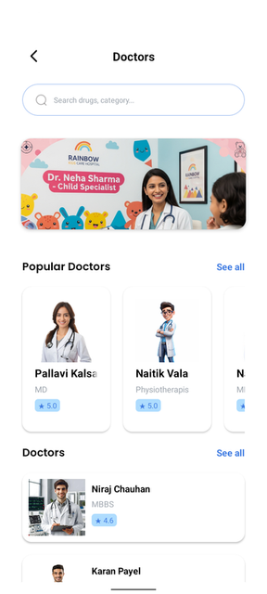
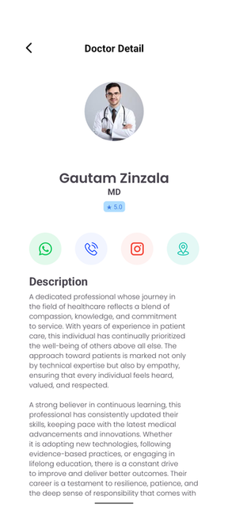
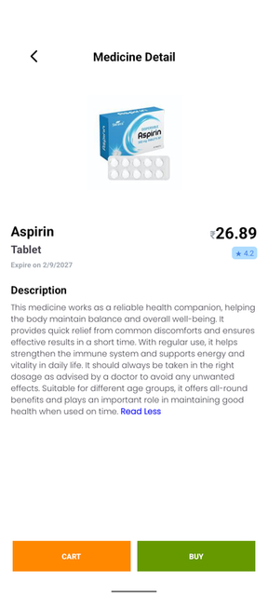
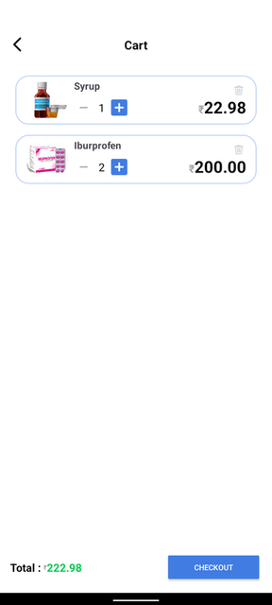
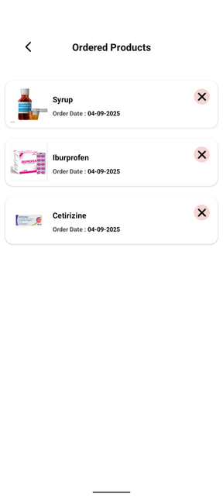
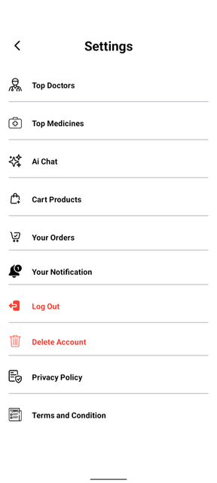
User Common Screens

Slide 20





Implementation (Working Flow)
Step 1: User Access
Users begin by securely logging in or registering a new account to access the app's features.
Step 2: Service Exploration
Users can then search for specific medicines, find doctors, or stay updated with the latest health news.
Step 3: Order & Tracking
For medicines, users add items to their cart, place orders, and can track the status of their delivery.
Step 4: SOS Activation
In emergencies, users can quickly activate the SOS feature for immediate medical assistance.
Step 5: Session End
Finally, users can securely log out, ensuring their data privacy.
Notes:
1.7.2013
19
‹#›

Slide 21






Advantages / Benefits
Easy to Use
Time-Saving
User-friendly design ensures simple navigation for students and general users.
Efficient search for doctors and medicines reduces waiting times and effort.
Paperless Records
24/7 Access
Digital healthcare records for easy management and access, promoting sustainability.
Continuous availability with dedicated emergency support for immediate assistance.
Notes:
1.7.2013
20
‹#›

Slide 22




Limitations & Future Scope
Limitations
Future Scope
Requires an active internet connection for full functionality.
Implement real-time telemedicine video consultation features.
Initial phase may have limited doctor availability in certain regions.
Develop an advanced AI chatbot with more interactive capabilities.
AI chat provides general guidance; not a substitute for professional medical advice.
Integrate AI-based health analysis for personalized user insights.
Explore partnerships with educational institutions for online health-related exams.
Notes:
1.7.2013
21
‹#›

Slide 23




Conclusion
Smart & Swift Solutions
Addressing Key Needs
Foundation for Growth
The Health Care Android App provides intelligent and quick healthcare solutions at your fingertips, leveraging technology for user convenience.
It effectively solves critical problems such as medicine search, doctor access, and immediate emergency assistance, streamlining healthcare processes.
Beyond being a successful college project, the app has significant potential for future expansion and development into a comprehensive healthcare platform.
Notes:
1.7.2013
22
‹#›

Slide 24

Thank You for Your Kindness
Notes:
1.7.2013
23
‹#›

